Slide 1
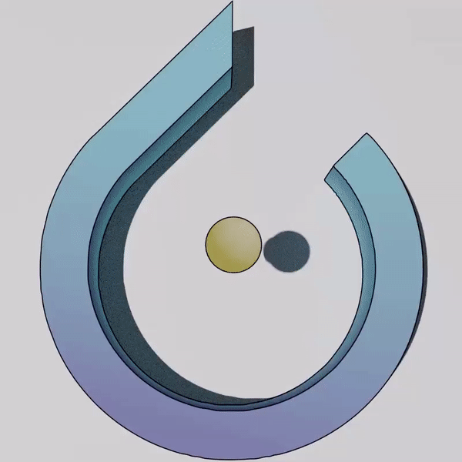



NeuralODEs
A journey
Computational Statistics | 01/03/2022
Luca Caivano Paulina Moskwa Manfred Nesti

Slide 2
Roadmap
Model
1
2
2D Dataset
From ResNets
to Neural Ordinary
Differential Equations
(NeuralODEs)
NeuralODEs for Binary Classification of problematic dataset:
half-moons, concentric annuli, concentric spirals
MNIST Dataset
3
4
Conclusions
NeuralODEs for
Image Classification:
MNIST dataset
Advantages of NeuralODEs

Slide 3

Neural Networks in a Nutshell

Slide 4
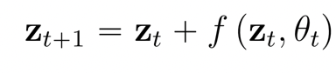
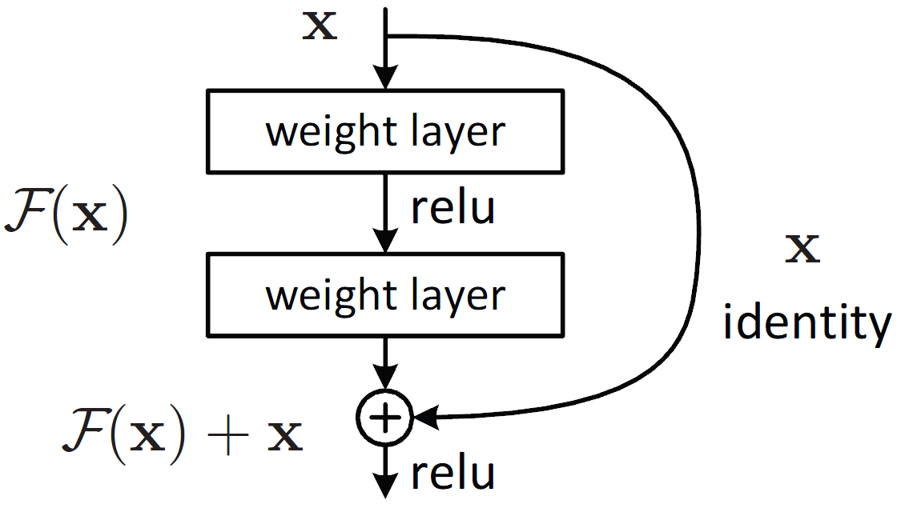
From ResNet to NeuralODE
ResNet

Slide 5
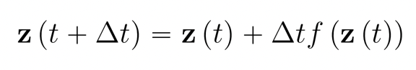
From ResNet to NeuralODE
ResNet
Explicit Euler

Slide 6
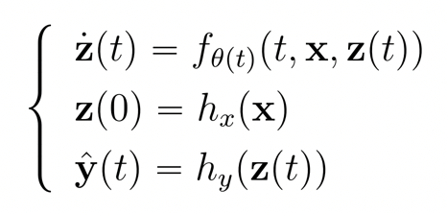
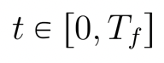
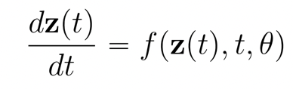
From ResNet to NeuralODE
ResNet
Explicit Euler
NeuralODE

Slide 7
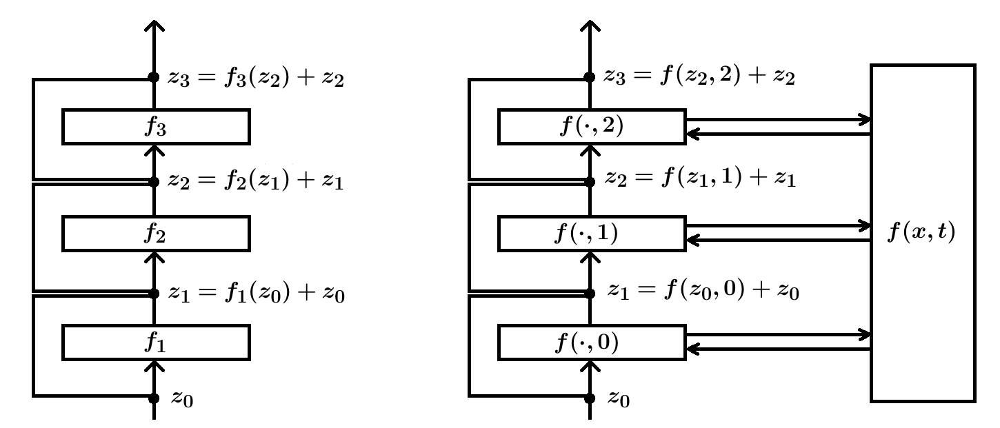
ResNet vs NeuralODE
ResNet
ODENet

Slide 8
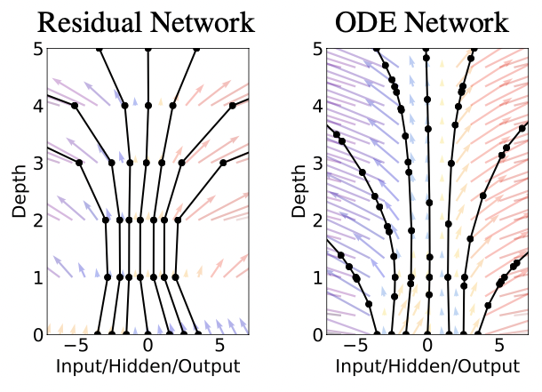
ResNet vs NeuralODE

Slide 9
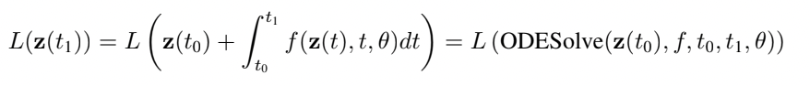
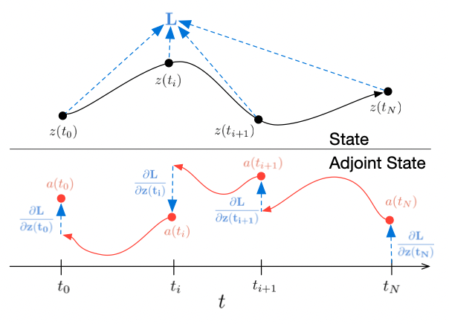
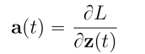
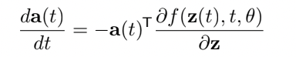
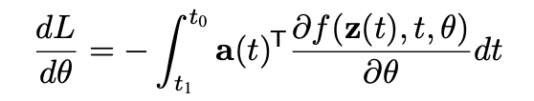
Adjoint method

Slide 10
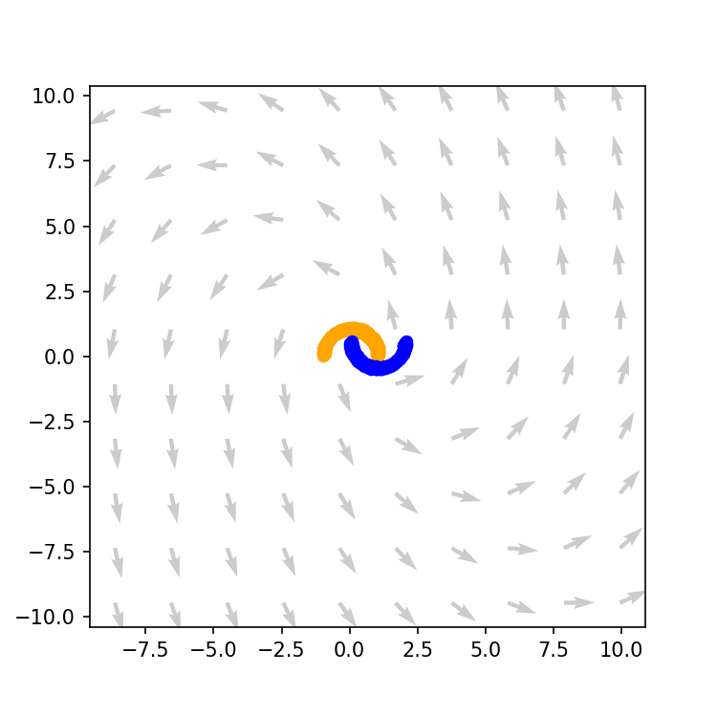
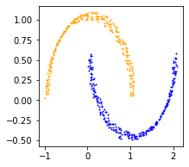
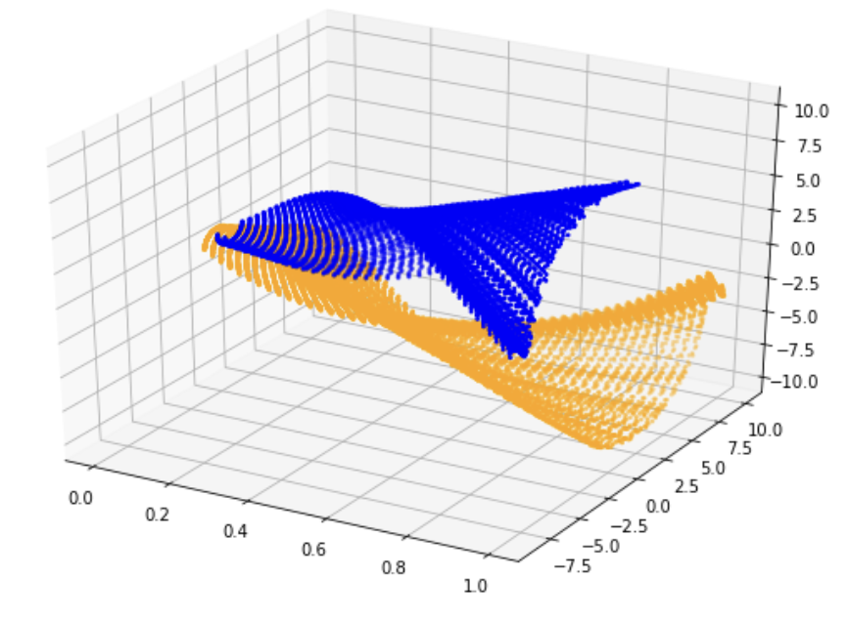
2D Classification
Half Moons Problem

Slide 11
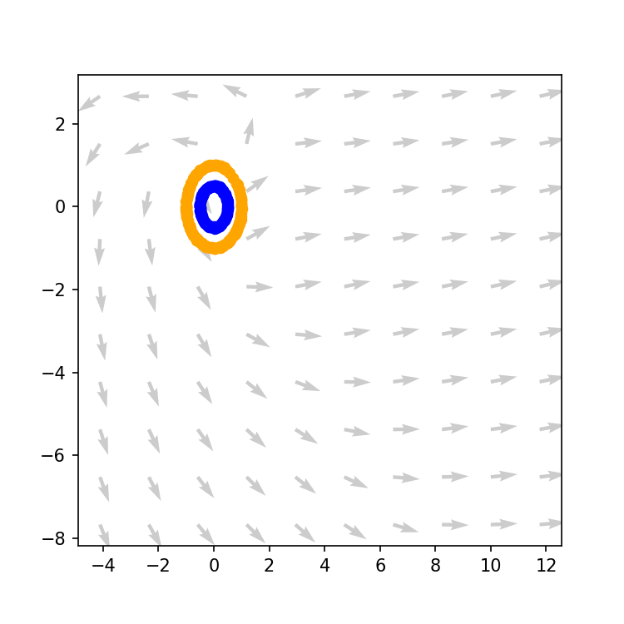
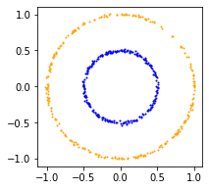
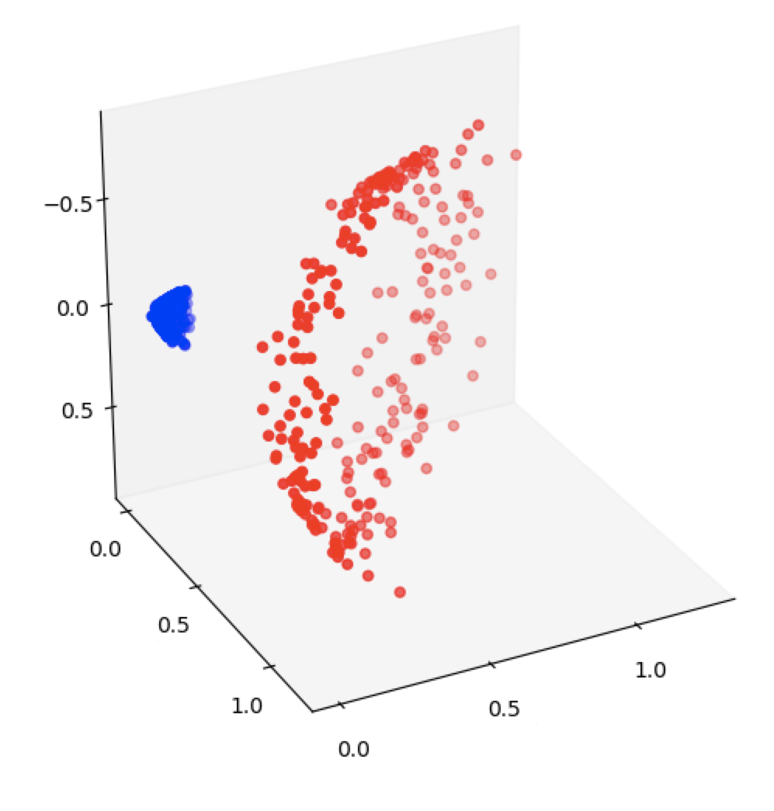
2D Classification
Concentric Annuli Problem

Slide 12
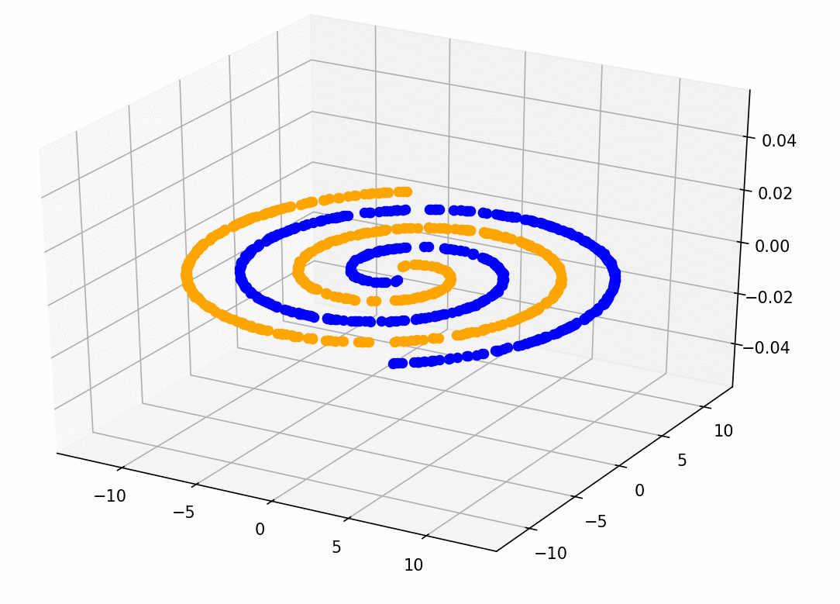
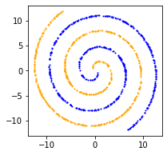
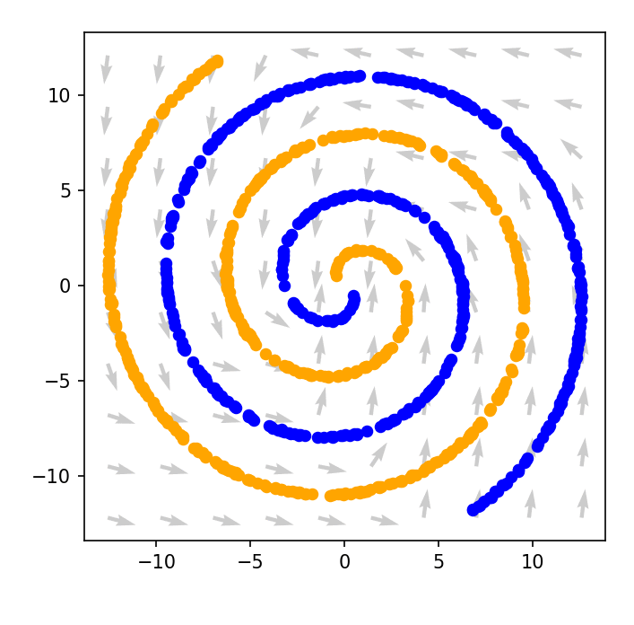
Augmented Classification
Concentric Spirals Problem
Augmented version

Slide 13
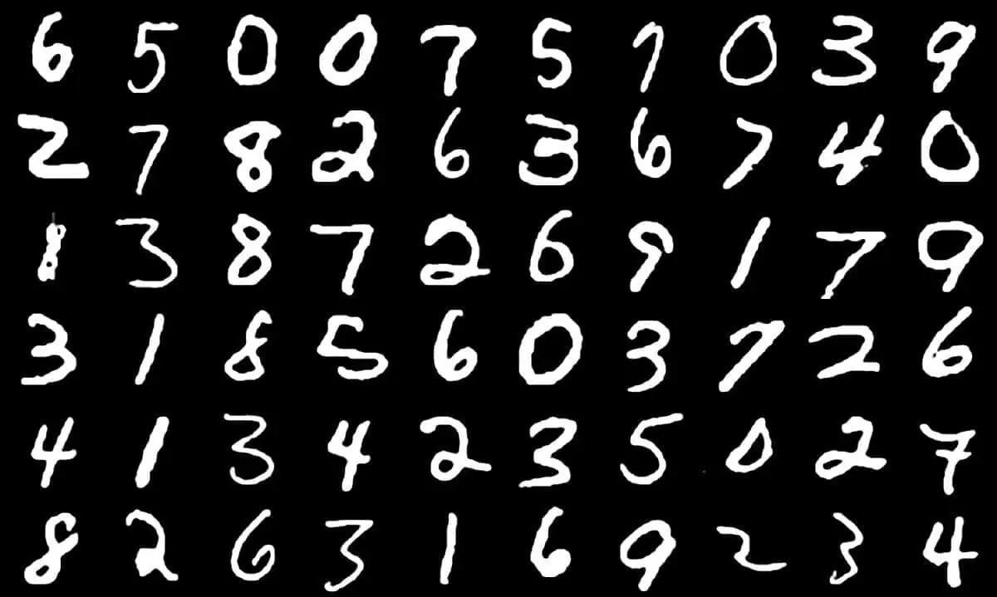
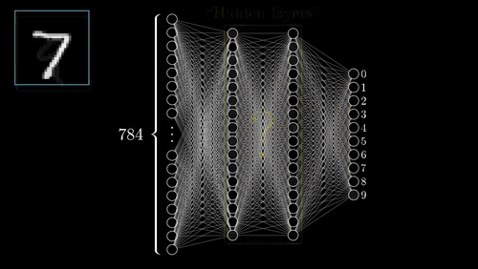
MNIST Dataset Classification

Slide 14
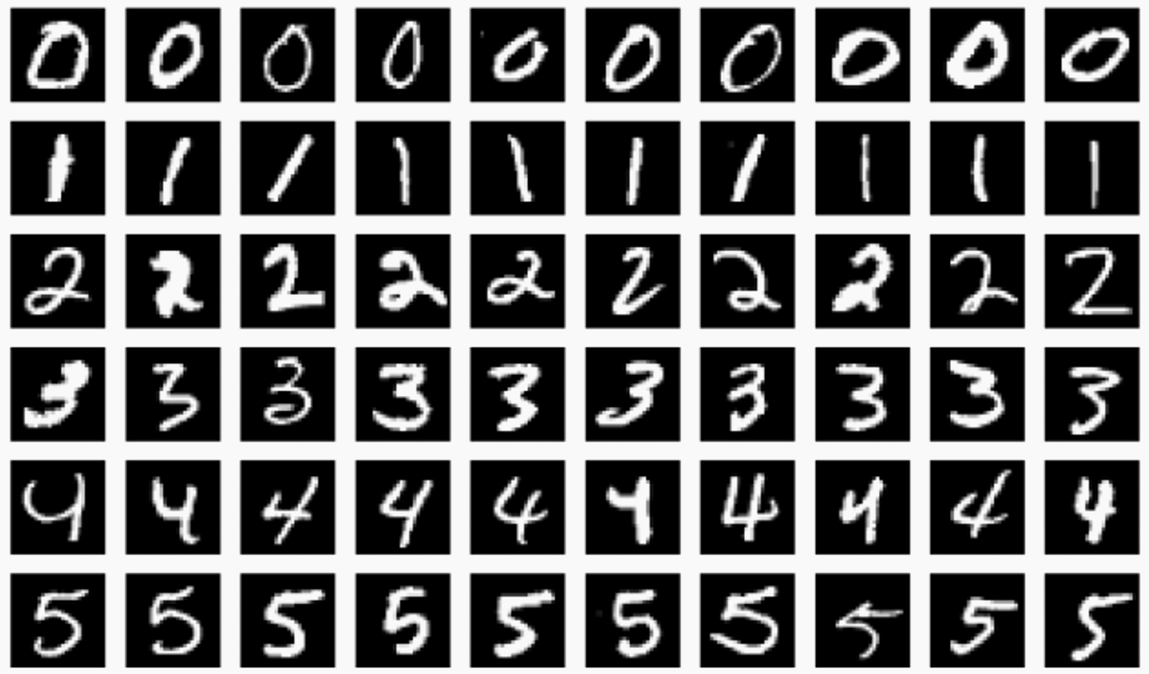
MNIST Dataset Classification

Slide 15
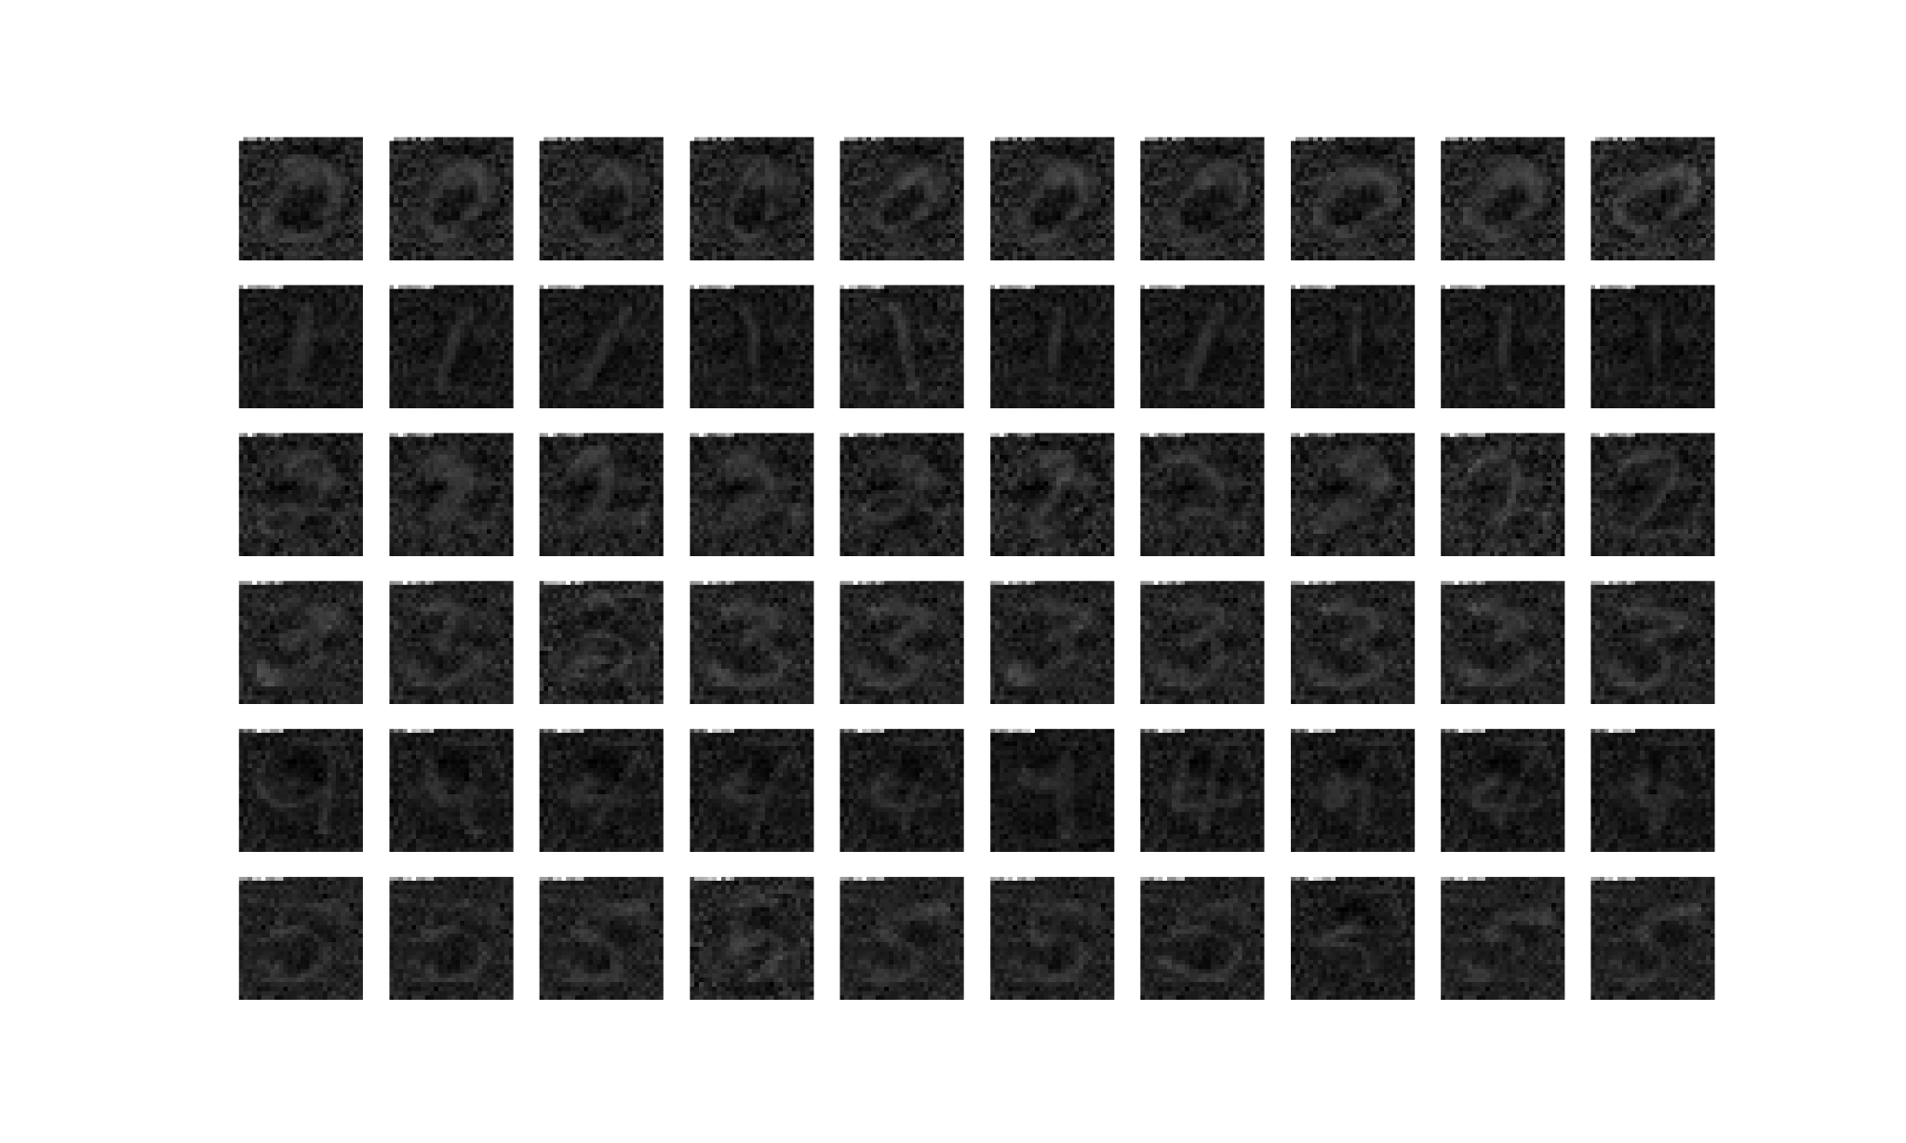
MNIST Dataset Classification

Slide 16
Accuracy on MNIST Dataset
-
99%
1.514.187
 | ODENet - Simple | ODENet - Expert
Accuracy on training set | 87.41% | -
Accuracy on test set | 86.57% | 99%
Number of parameters | 25.888 | 220.000
Best (CNN)

Slide 17
Conclusions
We can leverage years of developing of numerical solvers
ODE solver
NeuralODEs
Generally less training parameters than a standard NN
Memory efficiency
Generally less training time
than a standard NN
Training time
It can naturally incorporate data which arrives at arbitrary time
Continuous model
It can be explained easier than a standard NN thanks to the trajectories
Physical meaning

Slide 18

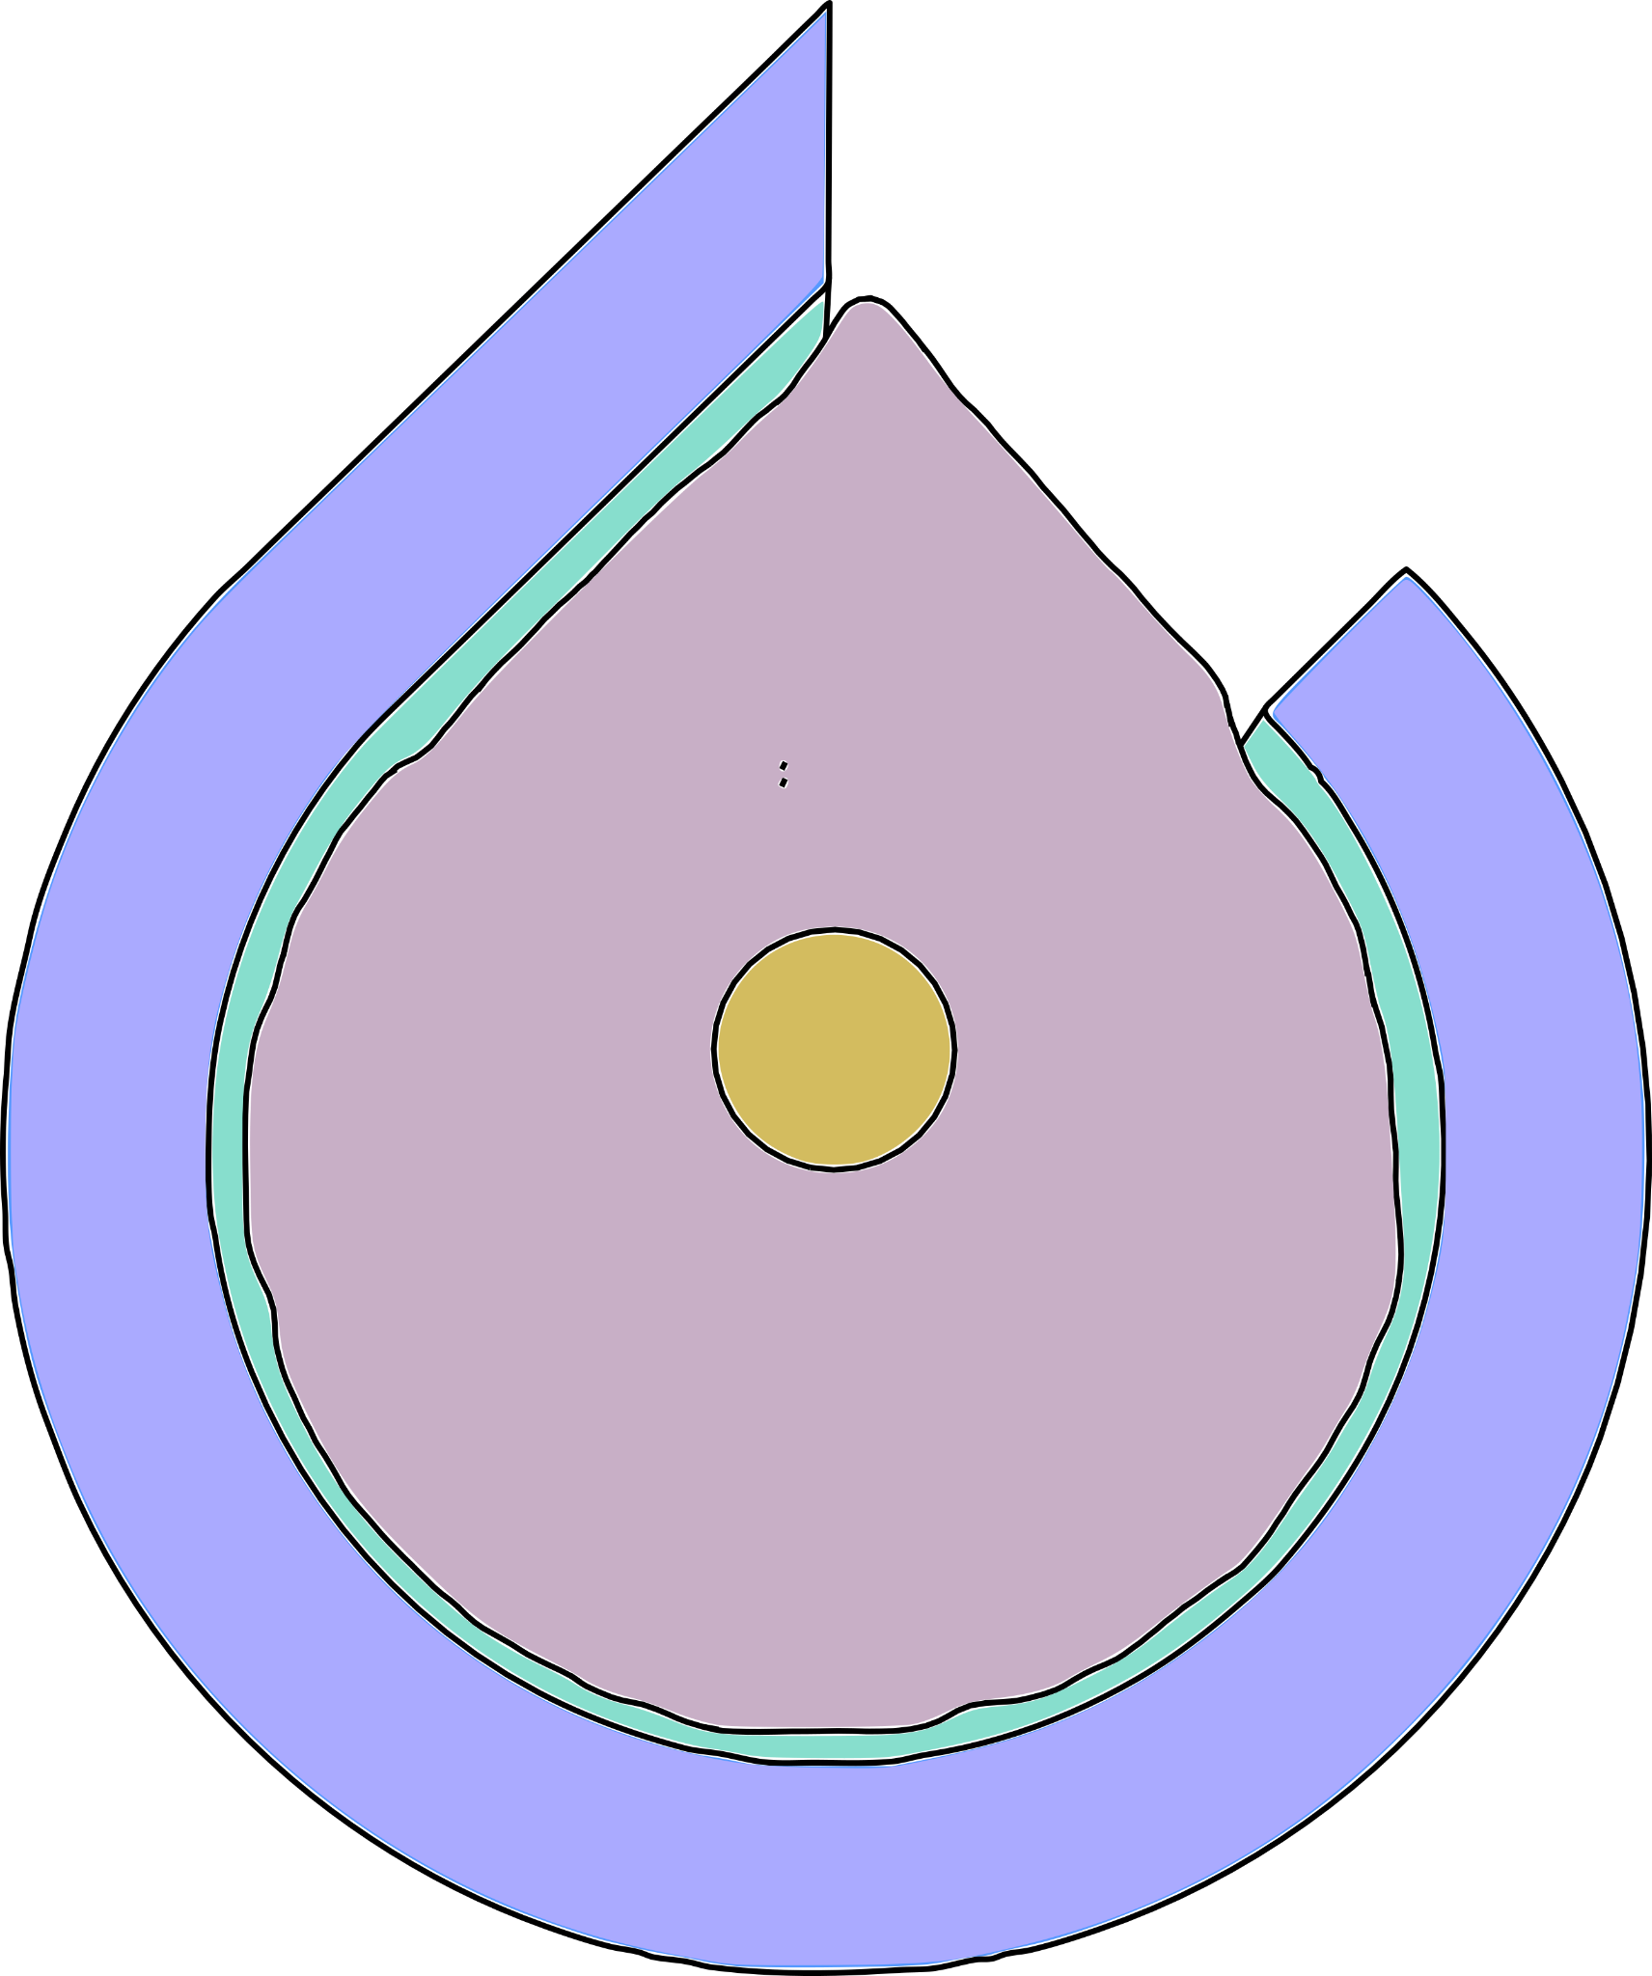

References
Ricky T. Q. Chen, et al. | “Neural Ordinary Differential Equations” |
32nd Conference on NeurIPS, 2019
S. Massaroli, M. Poli, et al. | “Dissecting NeuralODEs” |
34th Conference on NeurIPS, 2021
Software: TorchDyn: Implicit Models and Neural Numerical Methods in PyTorch | S.Massaroli, M. Poli, et. al | https://torchdyn.readthedocs.io/en/stable/tutorials/quickstart.html
Repository: Dissecting NeuralODEs |
S. Massaroli, M. Poli, et. al | https://github.com/DiffEqML/diffeqml-research/tree/master/dissecting-neural-odes
Repository: torchdyn/tutorials/ |
S. Massaroli, M. Poli, et. al | https://github.com/DiffEqML/torchdyn/tree/master/tutorials

Slide 19
Additional material

Slide 20
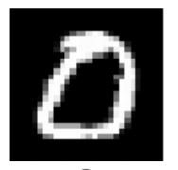
Accuracy on MNIST Dataset
Softmax
0 1 2 3 4 5 6 7 8 9
Probability vector
0 1 2 3 4 5 6 7 8 9
Output decision

Slide 21
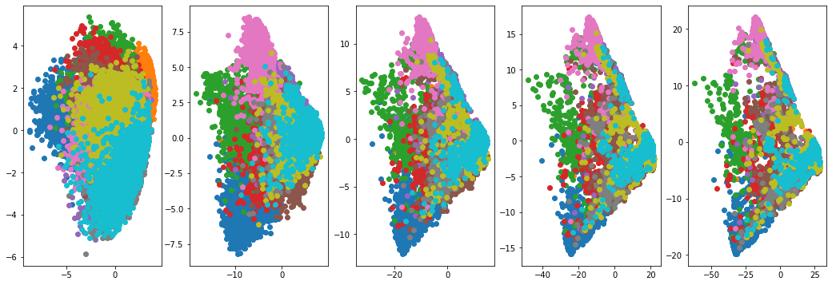
PCA on MNIST’s Trajectories
Time independent PCA
t=0.0 t=0.25 t=0.5 t=0.75 t=1.0

Slide 22
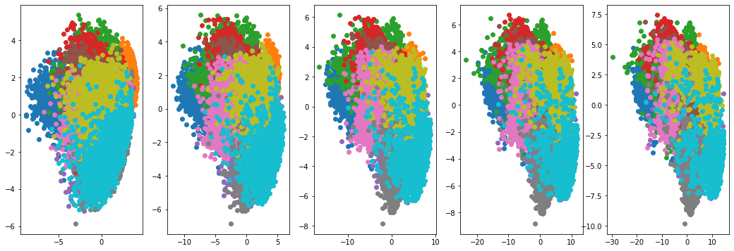
PCA on MNIST’s Trajectories
Time dependent PCA
t=0.0 t=0.25 t=0.5 t=0.75 t=1.0

